Slide 1

PCWG-Share-01 Introduction
8th October 2015 - Aarhus

Slide 2
PCWG-Share-01 Progress
PCWG-Share-01 Definition Document is now ready.
Submission process now clarified and documented in the PCWG-Share-01 Definition Document (results should be emailed to pcwg@nrel.gov).
Anonymous Report Format has been designed and agreed.
The Dataset Configuration GUI in the PCWG Analysis Tool has been substantially improved following feedback received at the June meeting (release 0.5.7).
Screencast demo prepared and released at www.pcwg.org
Further changes to the Analysis Configuration (‘Just Do It’ button) to be discussed today.
Organisations Committed to Participation:
US Developer (40 Datasets)
Developer & Consultant Combination (5 Datasets)
Developer & Consultant Combination (TBC Datasets)
Developer (20 Datasets)
Manufacturer (30 Datasets)

Slide 3
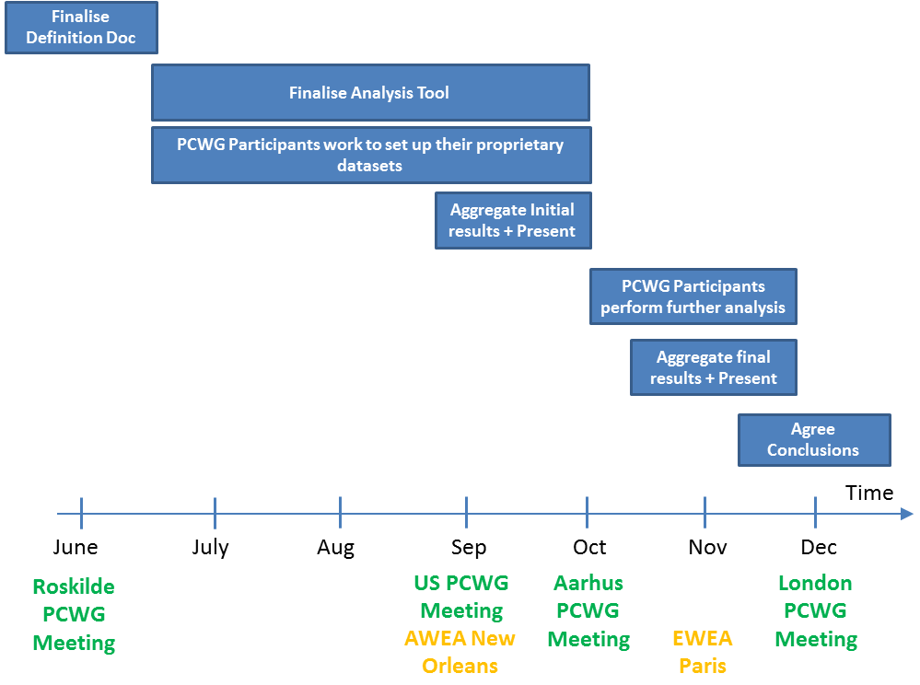
PCWG-Share-01 Timeline
Seek 100 datasets by December with draft results by November EWEA.

Slide 4
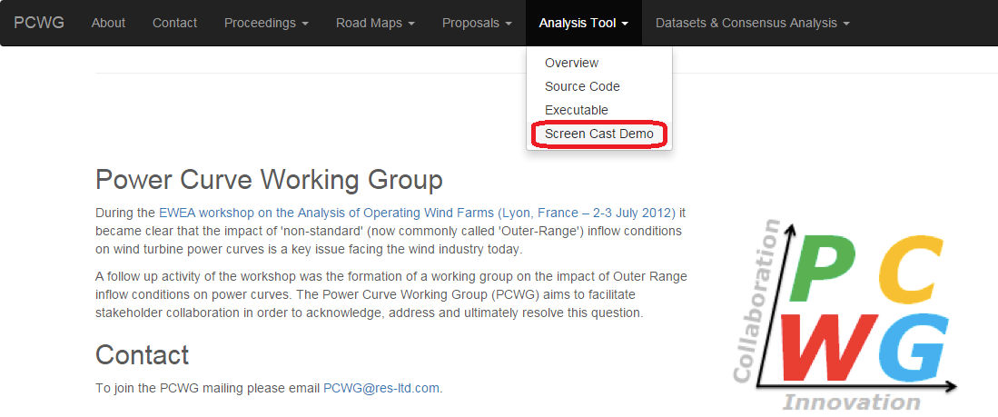
PCWG Screen Cast Demo
A step by step demo of setting up a dataset in the Analysis Tool has been published on the PCWG website:

Slide 5
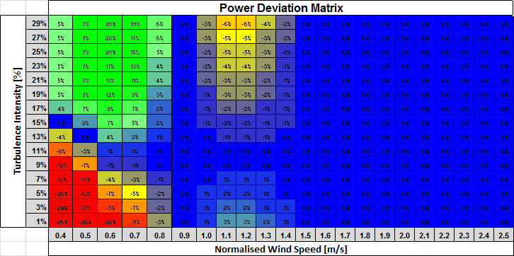
Power Deviation Matrix DRAFT Excel Consensus Analysis
DropBox\Power Deviation Matrix Consensus Analysis\Hypothesis Power Deviation Matrix DRAFT.xlsx
Power Deviation Matrix Consensus Analysis\Dataset 1\Dataset 1 - Power Deviation Matrix - DRAFT.xlsx
Power Deviation Matrix Consensus Analysis\Dataset 2\Dataset 2 - Power Deviation Matrix - DRAFT.xlsx
Power Deviation Matrix Consensus Analysis\Dataset 3\Dataset 3 - Power Deviation Matrix - DRAFT.xlsx

Slide 6
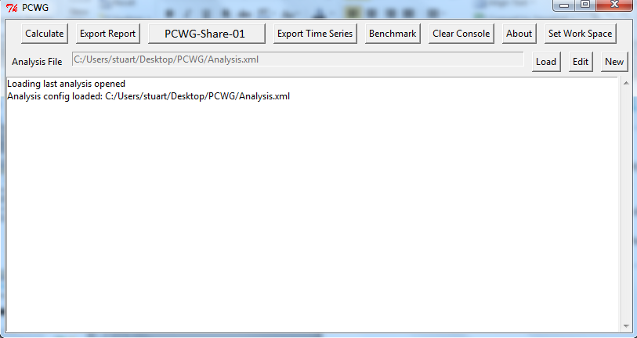
Analysis Configuration GUI Improvements
PCWG-Share-01 Wizard
Diameter
Hub Height
Datasets
GO

